Slide 1
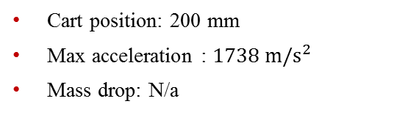
Datasets
High-Rate Overview
Benchmark
Applications
Datasets
Dataset 5 – test 21
Excitations:
Static cart action
Single hammer impact
No electromagnet mass
Cart position: 200 mm
Max acceleration : $1738 m/s^{2}$
Mass drop: N/a

Slide 2
Datasets
High-Rate Overview
Benchmark
Applications
Datasets
Dataset 5 – test 21
Excitations:
Static cart action
Single hammer impact
No electromagnet mass
Cart position: 200 mm
Max acceleration : $1738 m/s^{2}$
Mass drop: N/a

Slide 3

Datasets
High-Rate Overview
Benchmark
Applications
Datasets
Dataset 5 – test 22
Excitations:
Static cart action
Single hammer impact
Electromagnet mass
Cart position: 200 mm
Max acceleration : $229.5 m/s^{2}$
Mass drop: No

Slide 4
Datasets
High-Rate Overview
Benchmark
Applications
Datasets
Dataset 5 – test 22
Excitations:
Static cart action
Single hammer impact
Electromagnet mass
Cart position: 200 mm
Max acceleration : $229.5 m/s^{2}$
Mass drop: No

Slide 5

Datasets
High-Rate Overview
Benchmark
Applications
Datasets
Dataset 5 – test 23
Excitations:
Static cart action
Single hammer impact
Electromagnetic mass
Cart position: 200 mm
Max acceleration : $191.7 m/s^{2}$
Mass drop: No

Slide 6
Datasets
High-Rate Overview
Benchmark
Applications
Datasets
Dataset 5 – test 23
Excitations:
Static cart action
Single hammer impact
Electromagnetic mass
Cart position: 200 mm
Max acceleration : $191.7 m/s^{2}$
Mass drop: No

Slide 7
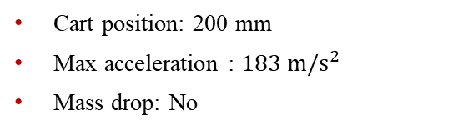
Datasets
High-Rate Overview
Benchmark
Applications
Datasets
Dataset 5 – test 24
Excitations:
Static cart action
Single hammer impact
Electromagnetic mass
Cart position: 200 mm
Max acceleration : $183 m/s^{2}$
Mass drop: No

Slide 8
Datasets
High-Rate Overview
Benchmark
Applications
Datasets
Dataset 5 – test 24
Excitations:
Static cart action
Single hammer impact
Electromagnetic mass
Cart position: 200 mm
Max acceleration : $183 m/s^{2}$
Mass drop: No

Slide 9

Datasets
High-Rate Overview
Benchmark
Applications
Datasets
Dataset 5 – test 25
Excitations:
Static cart action
Single hammer impact
No electromagnet mass
Cart position: 50 mm
Max acceleration : $183 m/s^{2}$
Mass drop: No

Slide 10
Datasets
High-Rate Overview
Benchmark
Applications
Datasets
Dataset 5 – test 25
Excitations:
Static cart action
Single hammer impact
No electromagnet mass
Cart position: 50 mm
Max acceleration : $183 m/s^{2}$
Mass drop: No

Slide 11

Datasets
High-Rate Overview
Benchmark
Applications
Datasets
Dataset 5 – test 26
Excitations:
Static cart action
Single hammer impact
No electromagnet mass
Cart position: 100 mm
Max acceleration : $215 m/s^{2}$
Mass drop: No

Slide 12
Datasets
High-Rate Overview
Benchmark
Applications
Datasets
Dataset 5 – test 26
Excitations:
Static cart action
Single hammer impact
No electromagnet mass
Cart position: 100 mm
Max acceleration : $215 m/s^{2}$
Mass drop: No

Slide 13

Datasets
High-Rate Overview
Benchmark
Applications
Datasets
Dataset 5 – test 27
Excitations:
Static cart action
Single hammer impact
No electromagnet mass
Cart position: 150 mm
Max acceleration : $75 m/s^{2}$
Mass drop: No

Slide 14
Datasets
High-Rate Overview
Benchmark
Applications
Datasets
Dataset 5 – test 27
Excitations:
Static cart action
Single hammer impact
No electromagnet mass
Cart position: 150 mm
Max acceleration : $75 m/s^{2}$
Mass drop: No

Slide 15

Datasets
High-Rate Overview
Benchmark
Applications
Datasets
Dataset 5 – test 28
Excitations:
Static cart action
Single hammer impact
No electromagnet mass
Cart position: 200 mm
Max acceleration : $600 m/s^{2}$
Mass drop: No

Slide 16
Datasets
High-Rate Overview
Benchmark
Applications
Datasets
Dataset 5 – test 28
Excitations:
Static cart action
Single hammer impact
No electromagnet mass
Cart position: 200 mm
Max acceleration : $600 m/s^{2}$
Mass drop: No

Slide 17

Datasets
High-Rate Overview
Benchmark
Applications
Datasets
Dataset 5 – test 29
Excitations:
Static cart action
Single hammer impact
No electromagnet mass
Cart position: 50 mm
Max acceleration : $424 m/s^{2}$
Mass drop: No

Slide 18
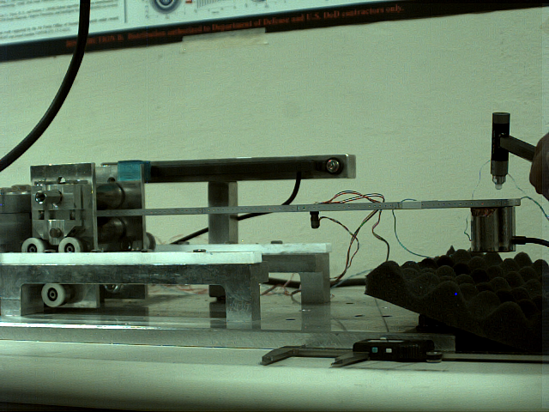
Datasets
High-Rate Overview
Benchmark
Applications
Datasets
Dataset 5 – test 29
Excitations:
Static cart action
Single hammer impact
No electromagnet mass
Cart position: 50 mm
Max acceleration : $424 m/s^{2}$
Mass drop: No

Slide 19

Datasets
High-Rate Overview
Benchmark
Applications
Datasets
Dataset 5 – test 30
Excitations:
Static cart action
Single hammer impact
Electromagnet mass
Cart position: 100 mm
Max acceleration : $618.9 m/s^{2}$
Mass drop: No

Slide 20
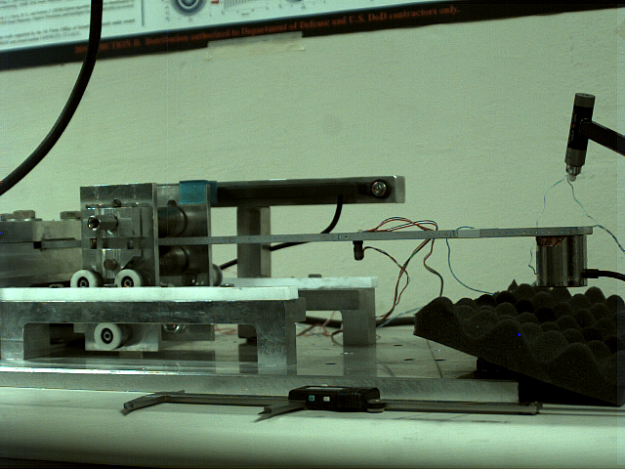
Datasets
High-Rate Overview
Benchmark
Applications
Datasets
Dataset 5 – test 30
Excitations:
Static cart action
Single hammer impact
Electromagnet mass
Cart position: 100 mm
Max acceleration : $618.9 m/s^{2}$
Mass drop: No

Slide 21

Datasets
High-Rate Overview
Benchmark
Applications
Datasets
Dataset 5 – test 31
Excitations:
Static cart action
Single hammer impact
Electromagnet mass
Cart position: 150 mm
Max acceleration : $1134 m/s^{2}$
Mass drop: No

Slide 22
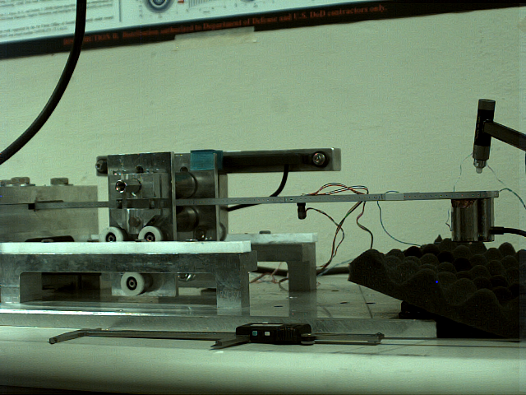
Datasets
High-Rate Overview
Benchmark
Applications
Datasets
Dataset 5 – test 31
Excitations:
Static cart action
Single hammer impact
Electromagnet mass
Cart position: 150 mm
Max acceleration : $1134 m/s^{2}$
Mass drop: No

Slide 23

Datasets
High-Rate Overview
Benchmark
Applications
Datasets
Dataset 5 – test 32
Excitations:
Static cart action
Single hammer impact
Electromagnet mass
Cart position: 200 mm
Max acceleration : 8$76 m/s^{2}$
Mass drop: No

Slide 24
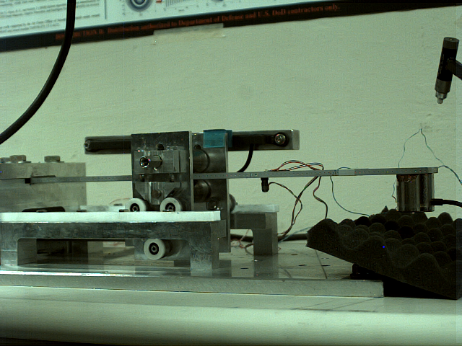
Datasets
High-Rate Overview
Benchmark
Applications
Datasets
Dataset 5 – test 32
Excitations:
Static cart action
Single hammer impact
Electromagnet mass
Cart position: 200 mm
Max acceleration : 8$76 m/s^{2}$
Mass drop: No

Slide 25

Datasets
High-Rate Overview
Benchmark
Applications
Datasets
Dataset 5 – test 33
Excitations:
Dynamic cart action
Single hammer impact
No electromagnet mass
Cart position: 50 -200 mm
Max acceleration : 2$606m/s^{2}$
Mass drop: N/a

Slide 26
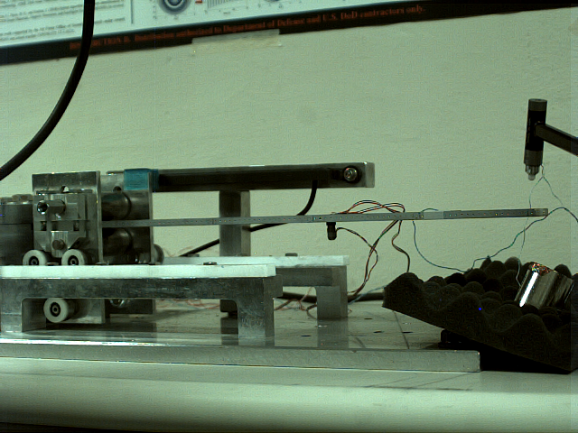
Datasets
High-Rate Overview
Benchmark
Applications
Datasets
Dataset 5 – test 33
Excitations:
Dynamic cart action
Single hammer impact
No electromagnet mass
Cart position: 50 -200 mm
Max acceleration : 2$606m/s^{2}$
Mass drop: N/a

Slide 27

Datasets
High-Rate Overview
Benchmark
Applications
Datasets
Dataset 5 – test 34
Excitations:
Dynamic cart action
Single hammer impact
Electromagnet mass drop
Cart position: 50 -200 mm
Max acceleration : $869.14 m/s^{2}$
Mass drop: 1 s

Slide 28
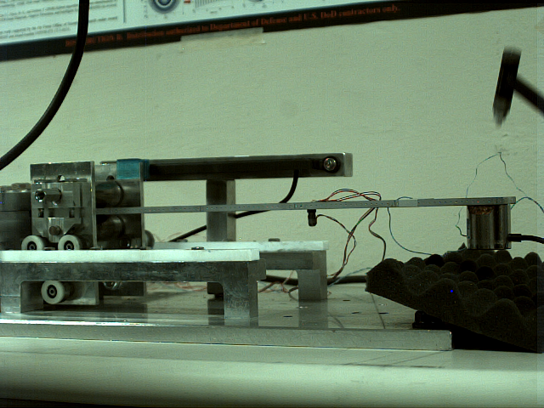
Datasets
High-Rate Overview
Benchmark
Applications
Datasets
Dataset 5 – test 34
Excitations:
Dynamic cart action
Single hammer impact
Electromagnet mass drop
Cart position: 50 -200 mm
Max acceleration : $869.14 m/s^{2}$
Mass drop: 1 s

Slide 29
Datasets
High-Rate Overview
Benchmark
Applications
Datasets
Dataset 6 – Sensors
Sensors:
2x Strain gauge
Both at 306 mm
1x Laser vibrometer
306 mm
1x Accelerometer (PCB 353B17)
306 mm
Sampling frequency: 25,000 samples/s
Excitation notes:
Hammer excitations shown on figures for each test
Dynamic cart action shown through figures if present

Slide 30
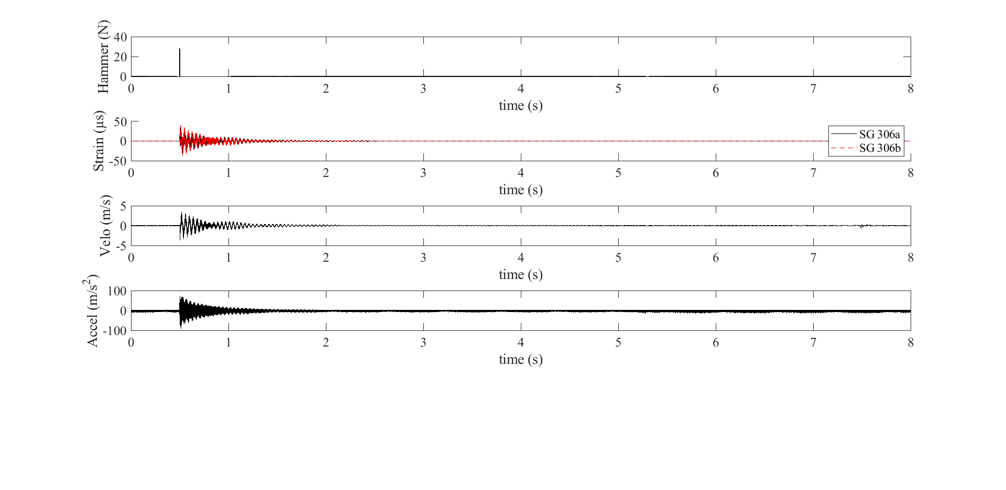
Datasets
High-Rate Overview
Benchmark
Applications
Datasets
Dataset 6 – test 1
Excitations:
Static cart action
No electromagnetic mass
Cart position: 50 mm
Mass drop time: No

Slide 31
Datasets
High-Rate Overview
Benchmark
Applications
Datasets
Dataset 6 – test 2
Excitations:
Static cart action
Electromagnetic mass
Cart position: 50 mm
Mass drop time: No

Slide 32
Datasets
High-Rate Overview
Benchmark
Applications
Datasets
Dataset 6 – test 3
Excitations:
Static cart action
No electromagnetic mass
Cart position: 100 mm
Mass drop time: No

Slide 33
Datasets
High-Rate Overview
Benchmark
Applications
Datasets
Dataset 6 – test 4
Excitations:
Static cart action
Electromagnetic mass
Cart position: 100 mm
Mass drop time: No

Slide 34
Datasets
High-Rate Overview
Benchmark
Applications
Datasets
Dataset 6 – test 5
Excitations:
Static cart action
No electromagnet mass
Cart position: 150 mm
Mass drop time: No
*Accelerometer FSIN 300

Slide 35
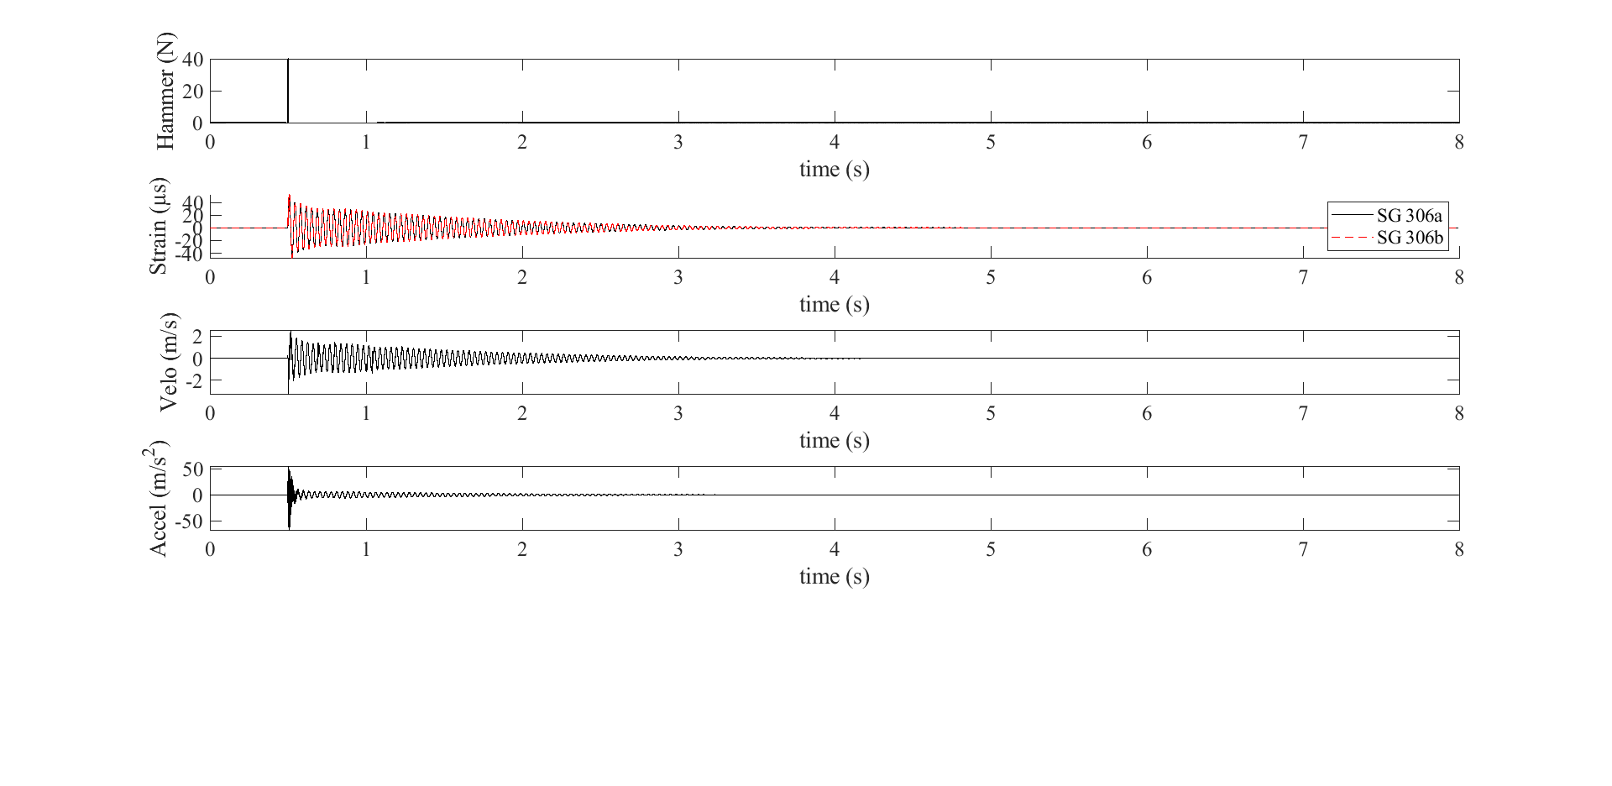
Datasets
High-Rate Overview
Benchmark
Applications
Datasets
Dataset 6 – test 6
Excitations:
Static cart action
Electromagnetic mass
Cart position: 200 mm
Mass drop time: No

Slide 36
Datasets
High-Rate Overview
Benchmark
Applications
Datasets
Dataset 6 – test 7
Excitations:
Static cart action
No electromagnet mass
Cart position: 200 mm
Mass drop time: No

Slide 37
Datasets
High-Rate Overview
Benchmark
Applications
Datasets
Dataset 6 – test 8
Excitations:
Static cart action
Electromagnetic mass
Cart position: 200 mm
Mass drop time: No

Slide 38
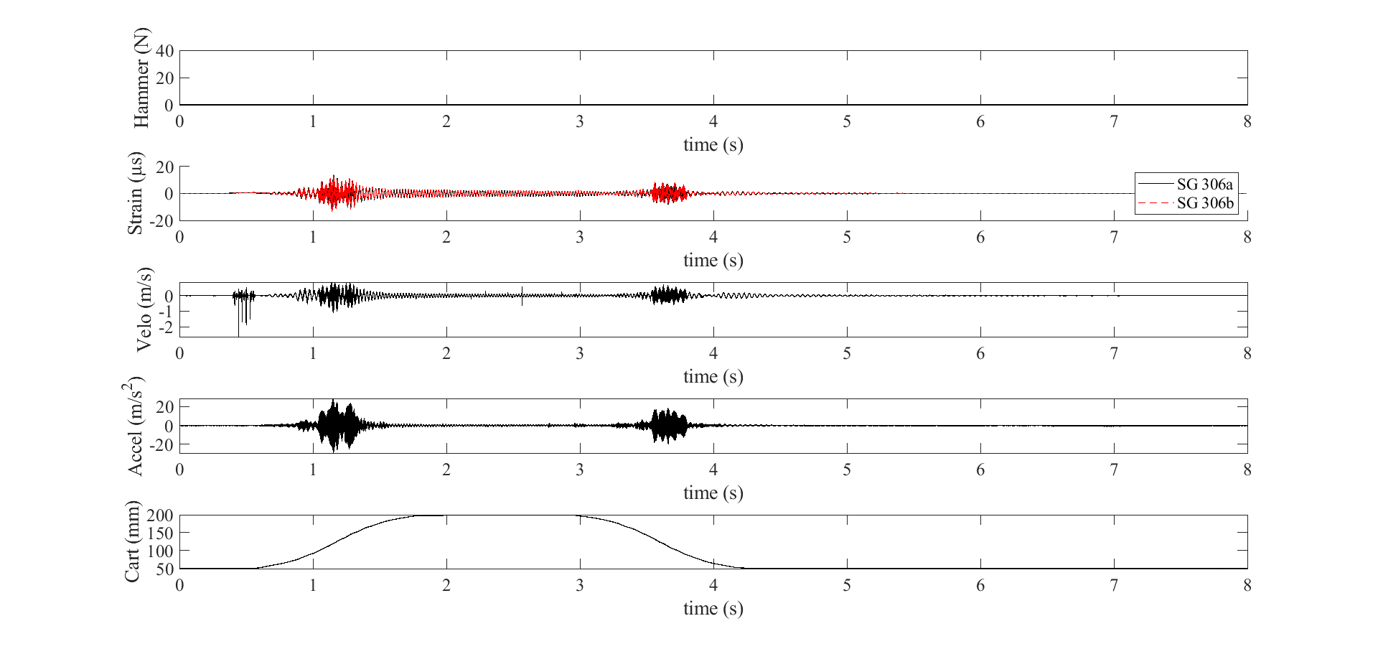
Datasets
High-Rate Overview
Benchmark
Applications
Datasets
Dataset 6 – test 9
Excitations:
No electromagnet mass
Mass drop time: No

Slide 39
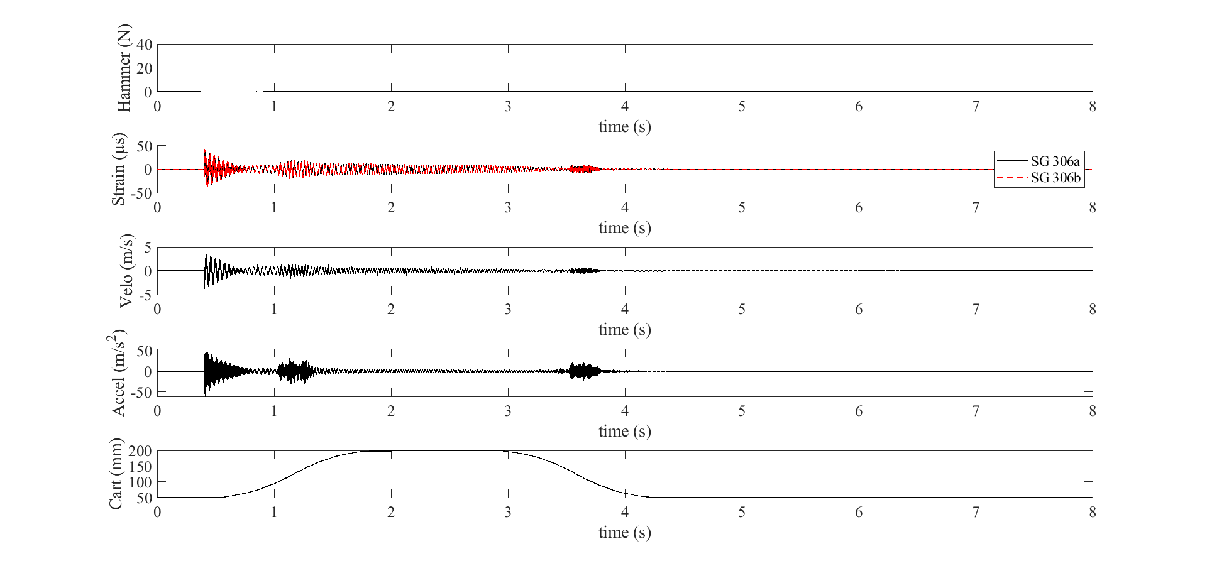
Datasets
High-Rate Overview
Benchmark
Applications
Datasets
Dataset 6 – test 10
Excitations:
No electromagnet mass
Mass drop time: No

Slide 40
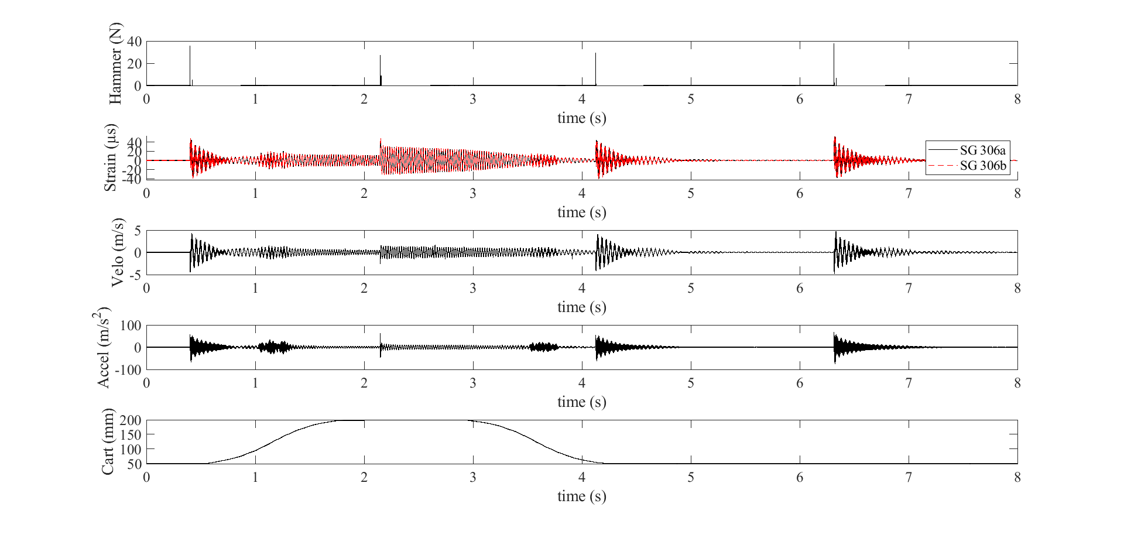
Datasets
High-Rate Overview
Benchmark
Applications
Datasets
Dataset 6 – test 11
Excitations:
No electromagnet mass
Mass drop time: No

Slide 41
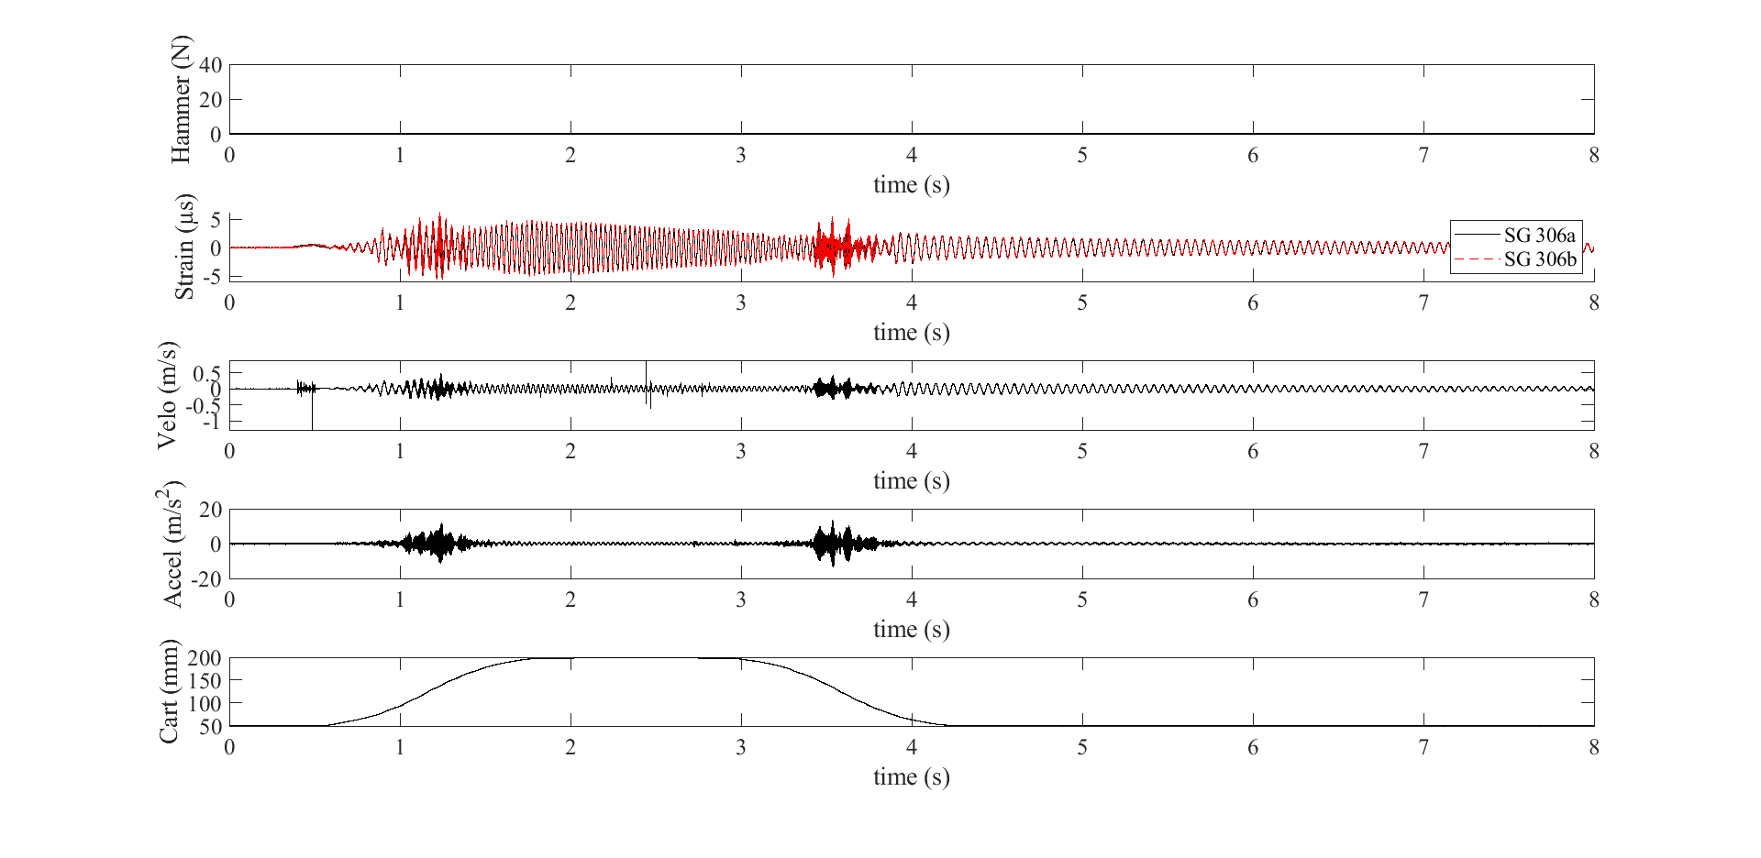
Datasets
High-Rate Overview
Benchmark
Applications
Datasets
Dataset 6 – test 12
Excitations:
Electromagnet mass
Mass drop time: No

Slide 42
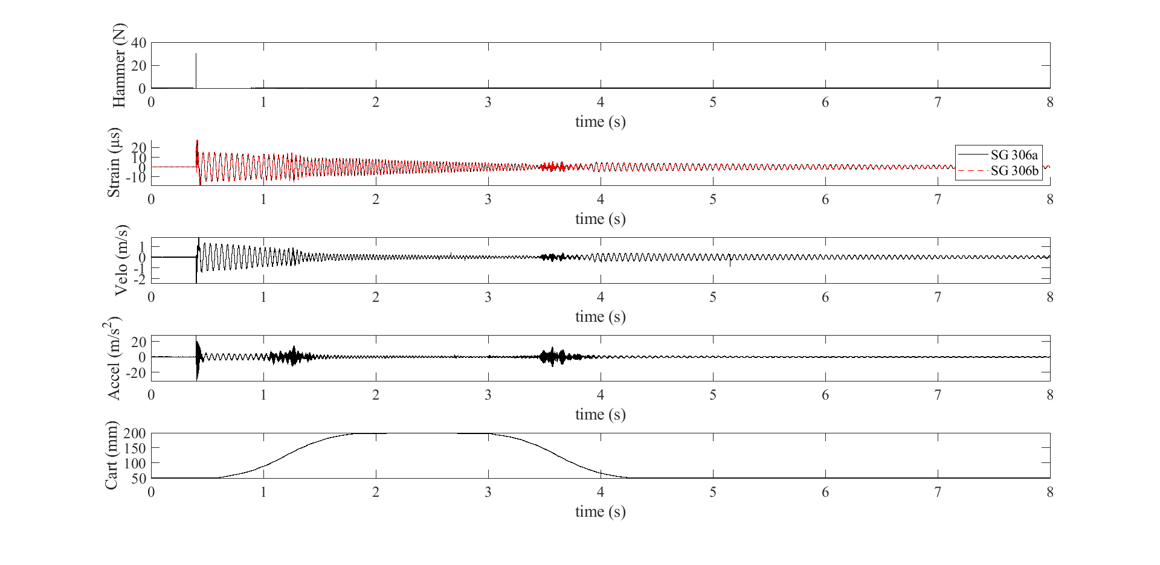
Datasets
High-Rate Overview
Benchmark
Applications
Datasets
Dataset 6 – test 13
Excitations:
Electromagnet mass
Mass drop time: No

Slide 43
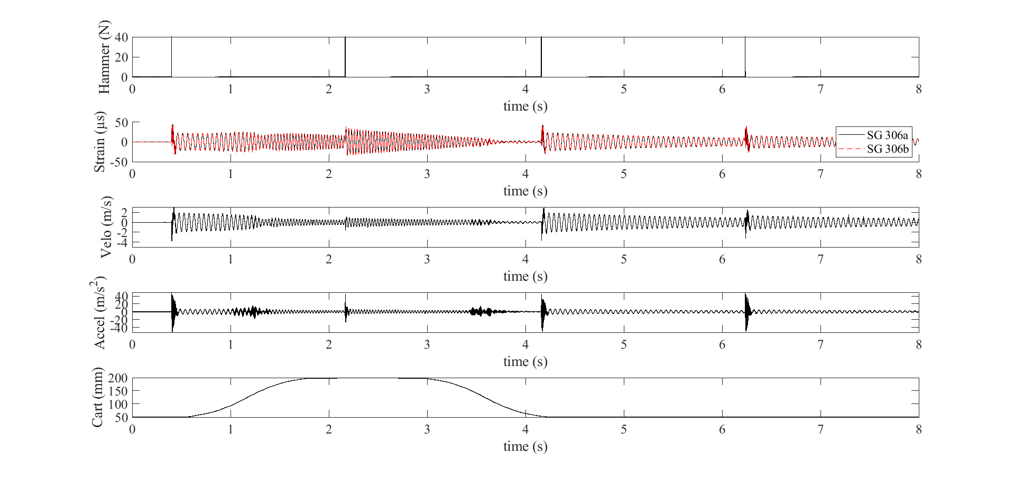
Datasets
High-Rate Overview
Benchmark
Applications
Datasets
Dataset 6 – test 14
Excitations:
Electromagnet mass
Mass drop time: No

Slide 44
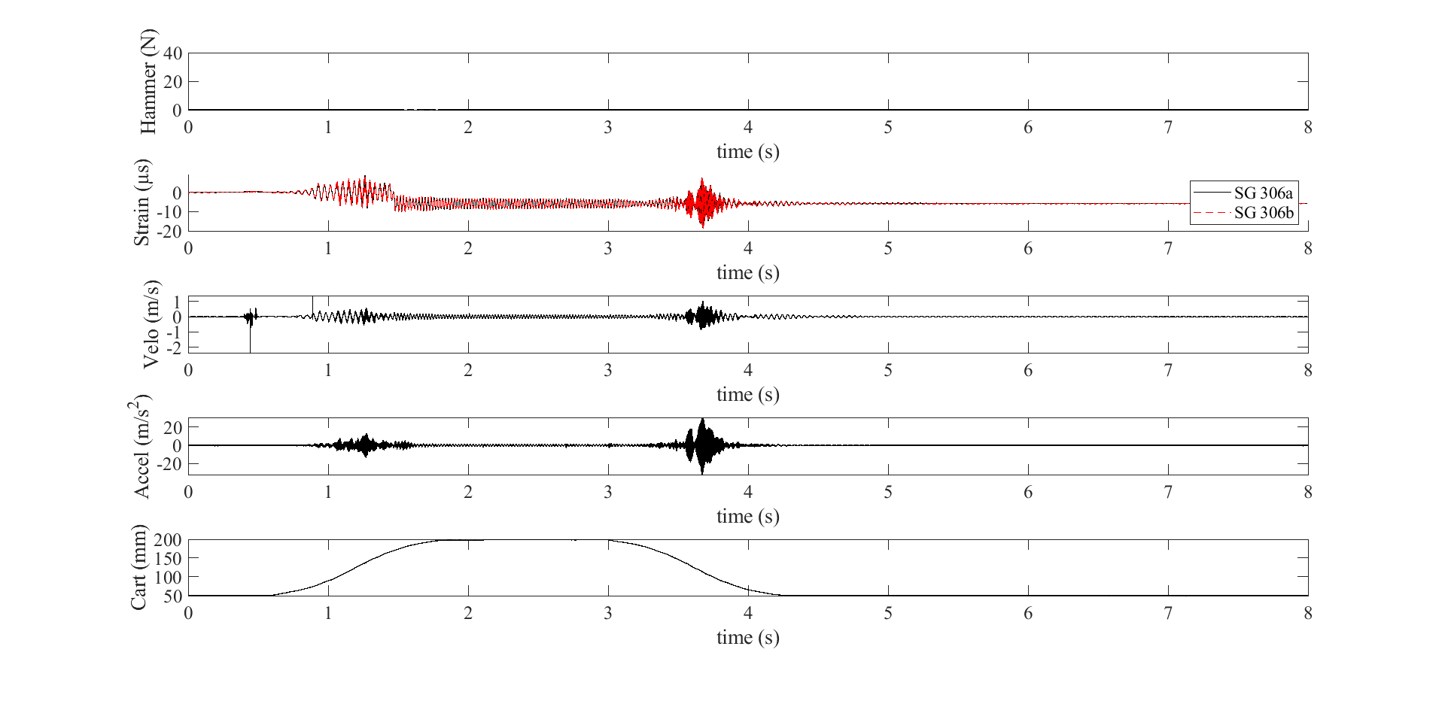
Datasets
High-Rate Overview
Benchmark
Applications
Datasets
Dataset 6 – test 15
Excitations:
Electromagnet mass
Mass drop time: 1 sec

Slide 45
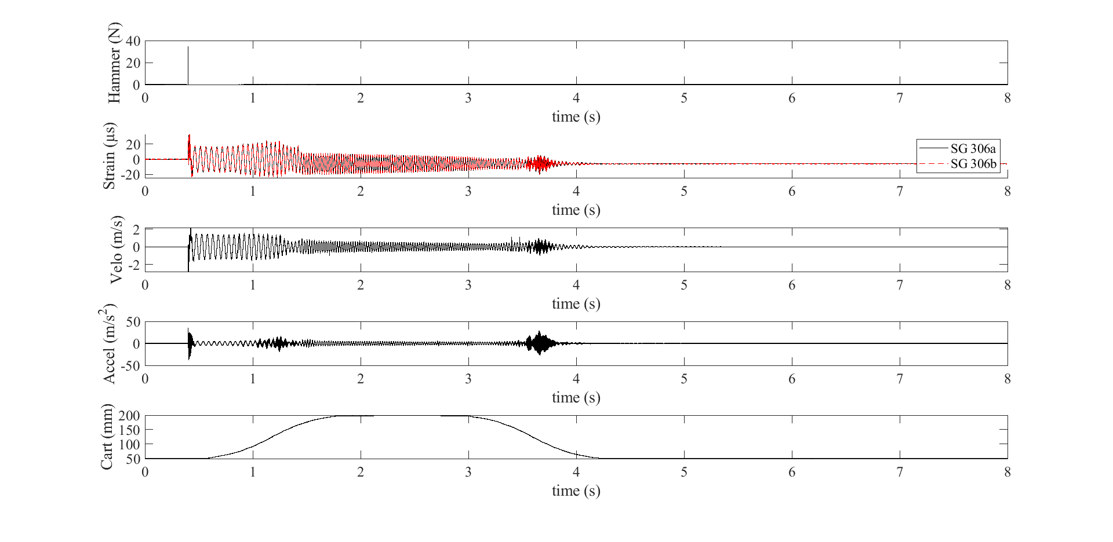
Datasets
High-Rate Overview
Benchmark
Applications
Datasets
Dataset 6 – test 16
Excitations:
Electromagnet mass
Mass drop time: 1 sec

Slide 46
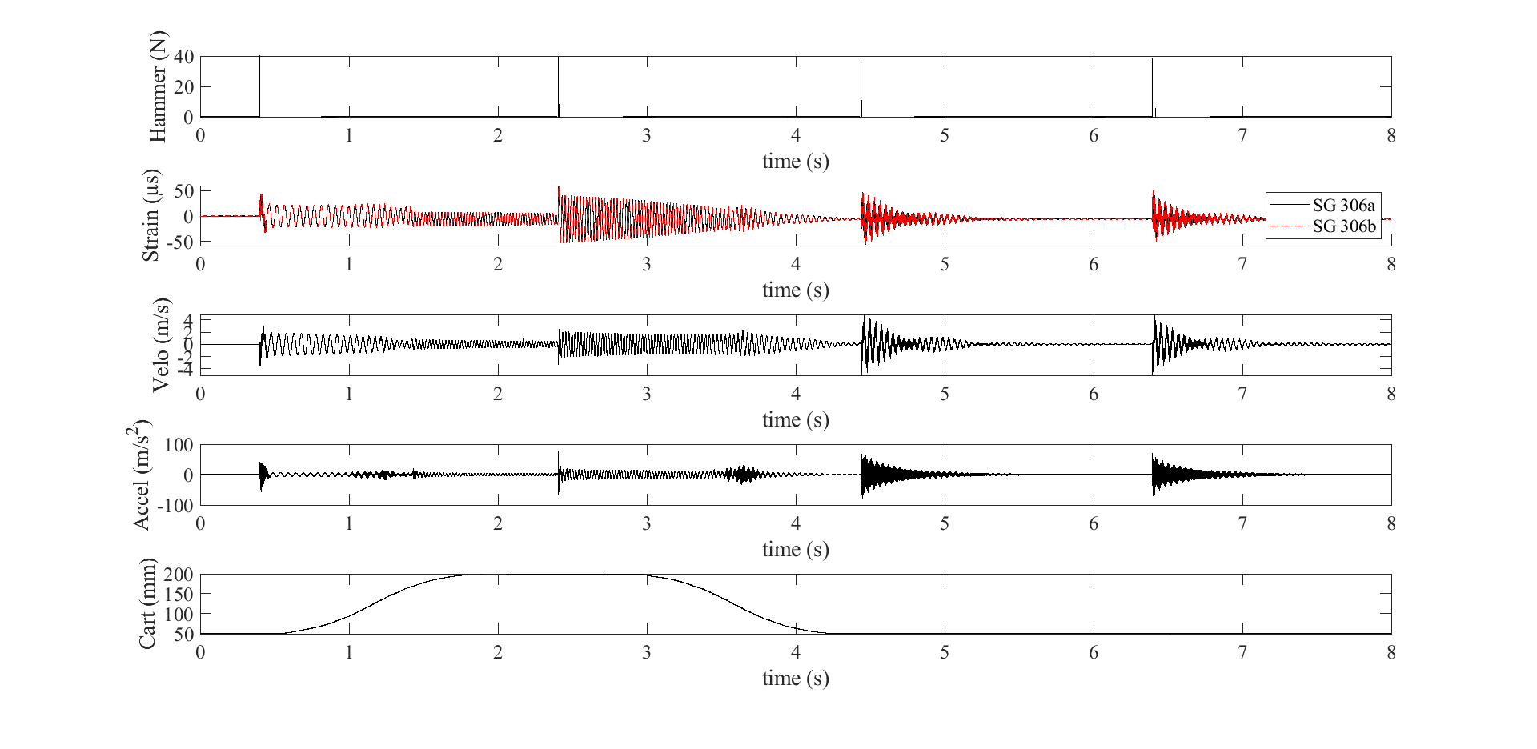
Datasets
High-Rate Overview
Benchmark
Applications
Datasets
Dataset 6 – test 17
Excitations:
Electromagnet mass
Mass drop time: 1 sec

Slide 47
Datasets
High-Rate Overview
Benchmark
Applications
Datasets
Dataset 7 – Sensors
Sensors:
2x Strain gauge
Both at 306 mm
1x Laser vibrometer
306 mm
1x Accelerometer (PCB 353B17)
306 mm
1x Extensometer
306 mm
Sampling frequency: 25,000 samples/s
Excitation notes:
Hammer excitations shown on figures for each test
Dynamic cart action shown through figures
No electromagnetic mass

Slide 48
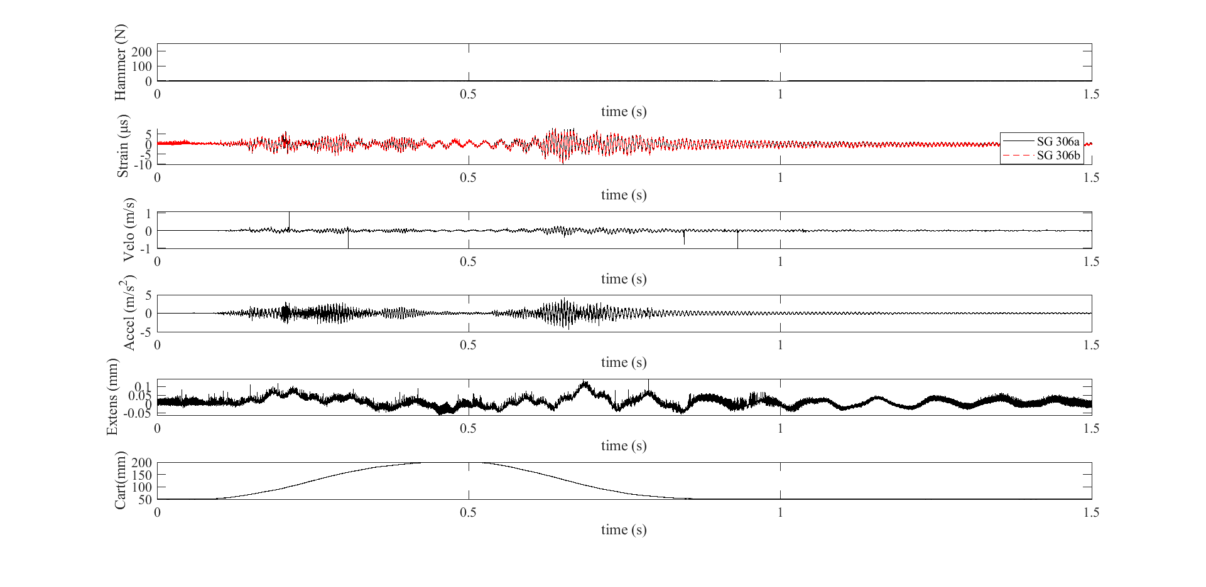
Datasets
High-Rate Overview
Benchmark
Applications
Datasets
Dataset 7 – test 1

Slide 49
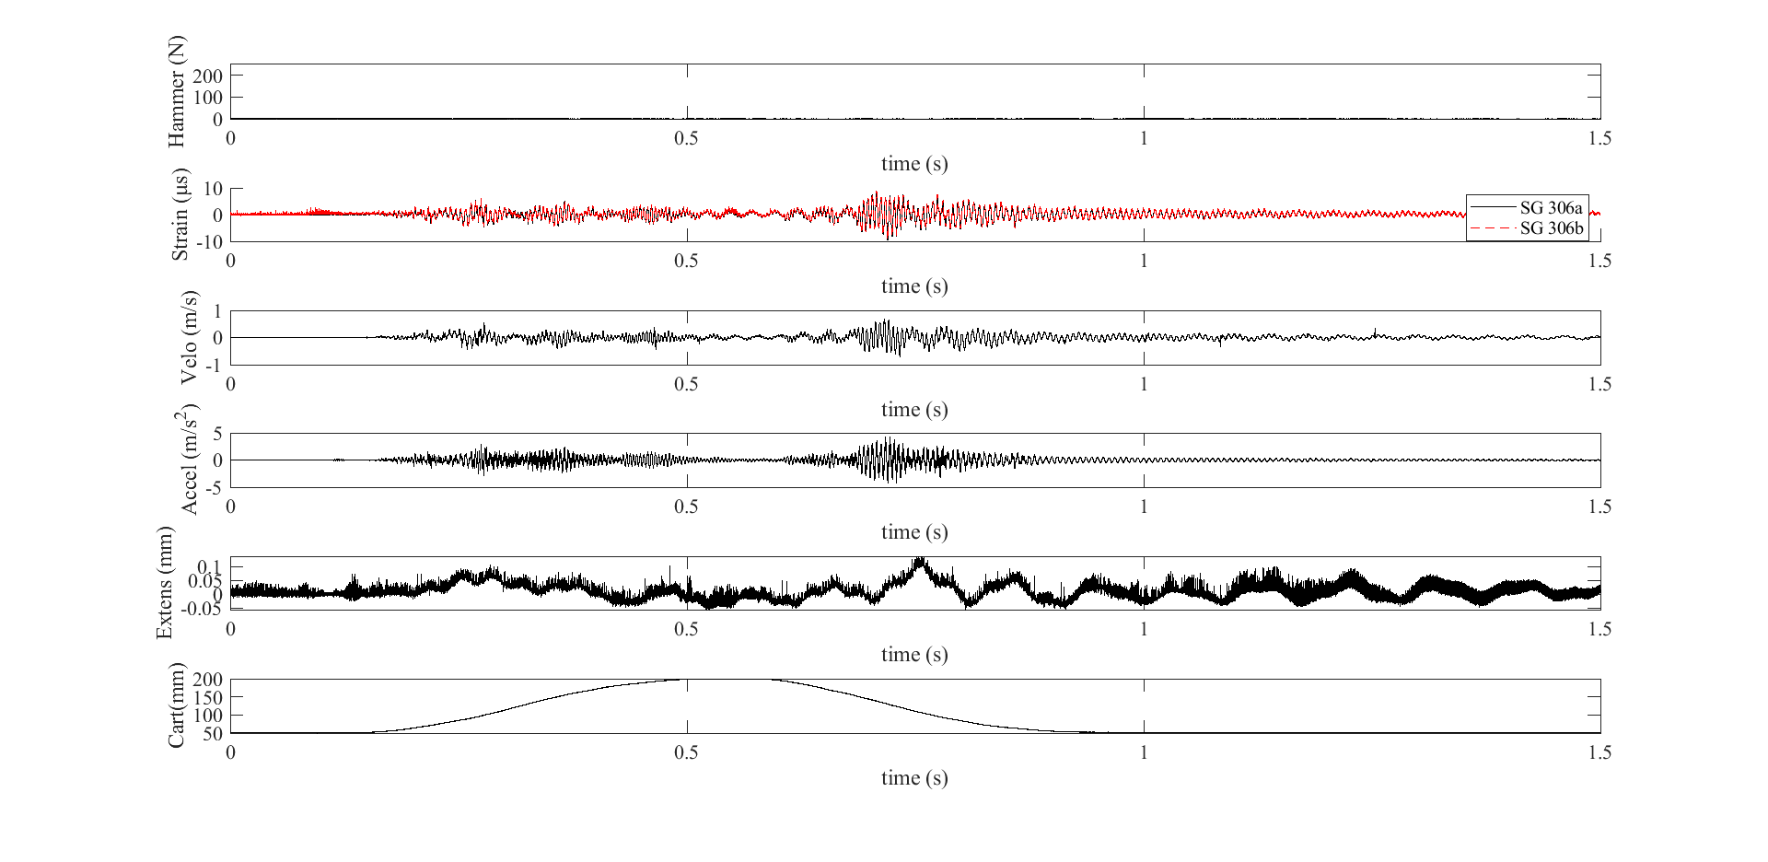
Datasets
High-Rate Overview
Benchmark
Applications
Datasets
Dataset 7 – test 2

Slide 50
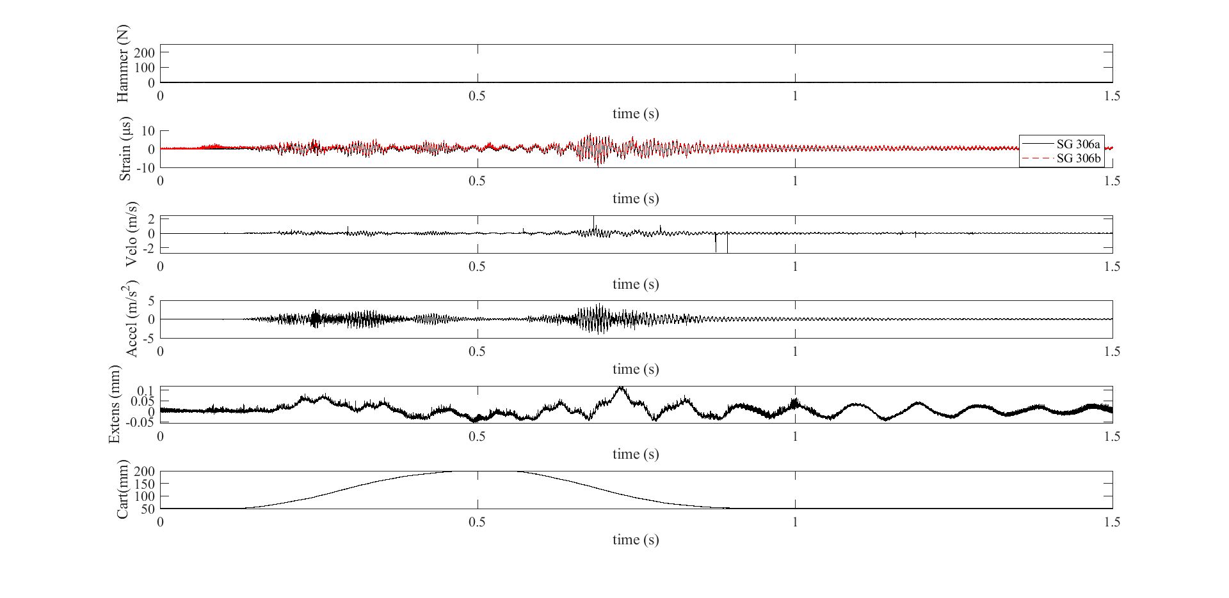
Datasets
High-Rate Overview
Benchmark
Applications
Datasets
Dataset 7 – test 3

Slide 51
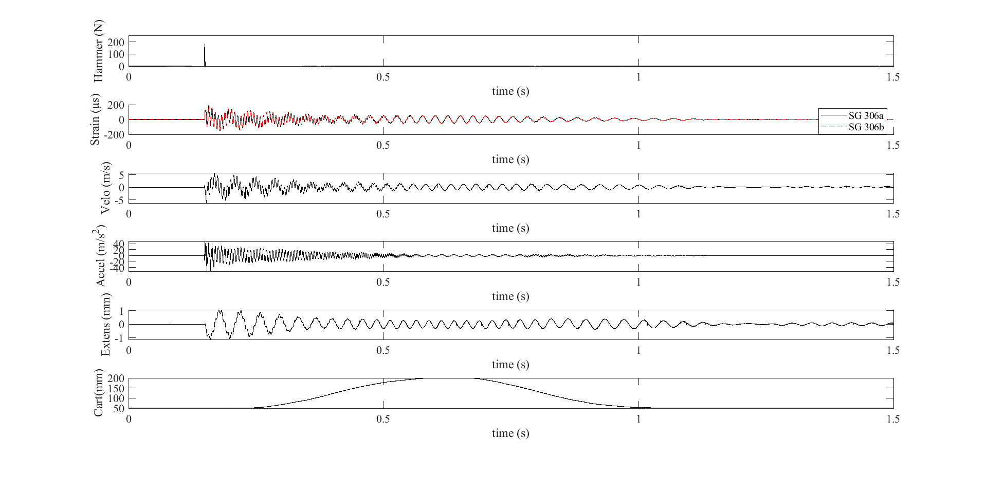
Datasets
High-Rate Overview
Benchmark
Applications
Datasets
Dataset 7 – test 4

Slide 52
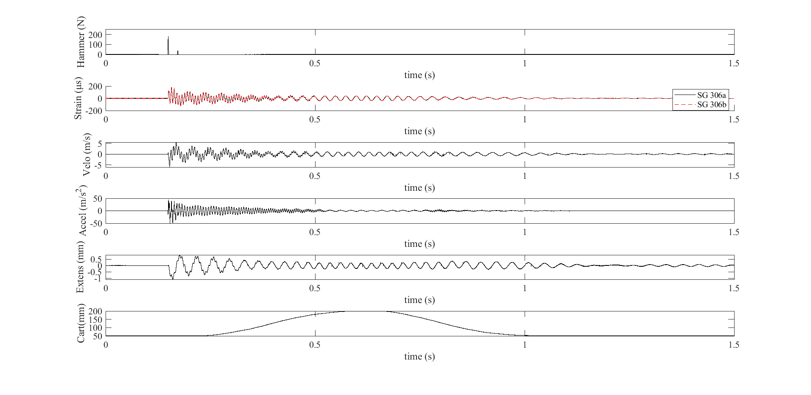
Datasets
High-Rate Overview
Benchmark
Applications
Datasets
Dataset 7 – test 5

Slide 53
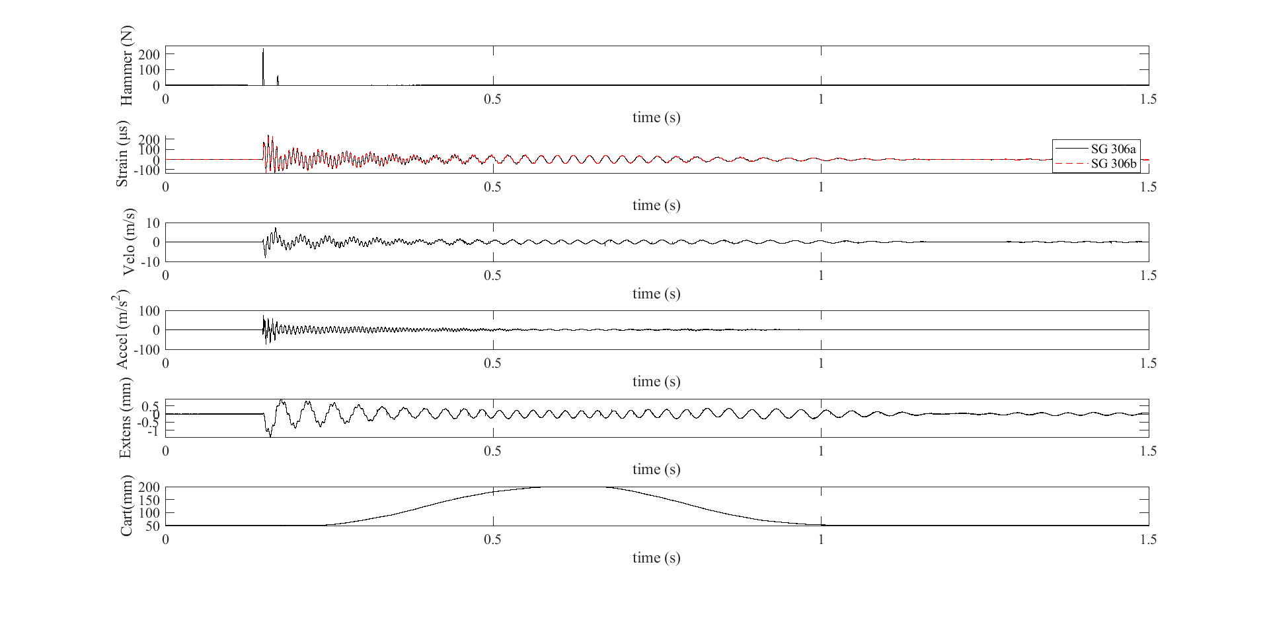
Datasets
High-Rate Overview
Benchmark
Applications
Datasets
Dataset 7 – test 6

Slide 54
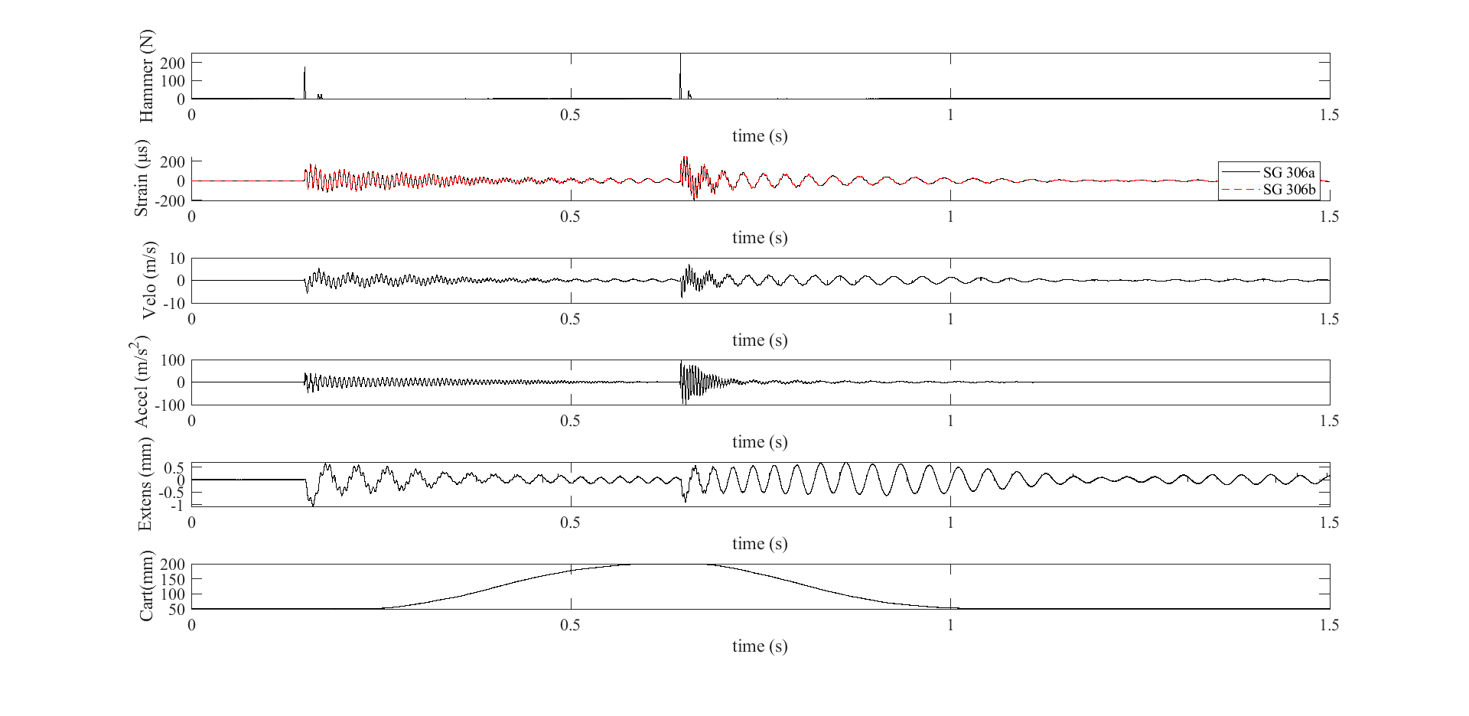
Datasets
High-Rate Overview
Benchmark
Applications
Datasets
Dataset 7 – test 7

Slide 55
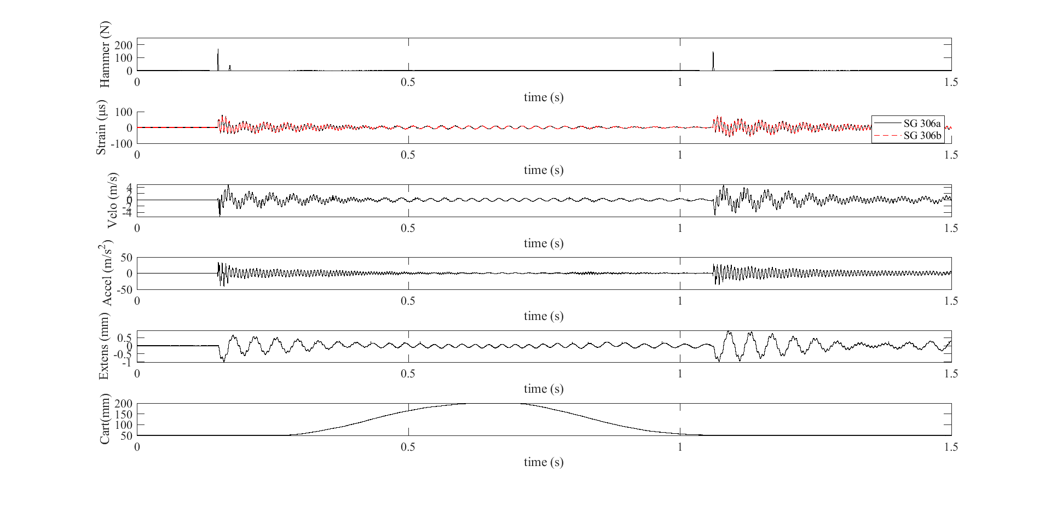
Datasets
High-Rate Overview
Benchmark
Applications
Datasets
Dataset 7 – test 8

Slide 56
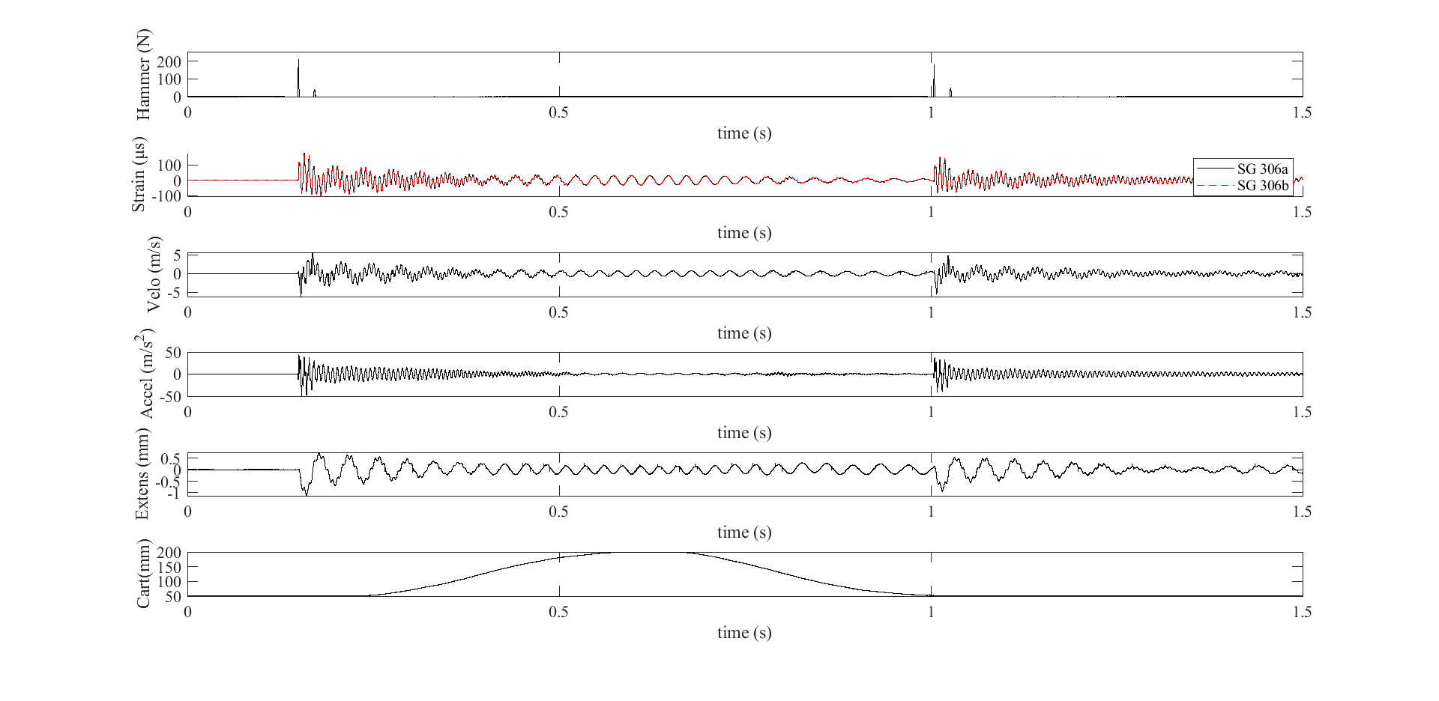
Datasets
High-Rate Overview
Benchmark
Applications
Datasets
Dataset 7 – test 9

Slide 57
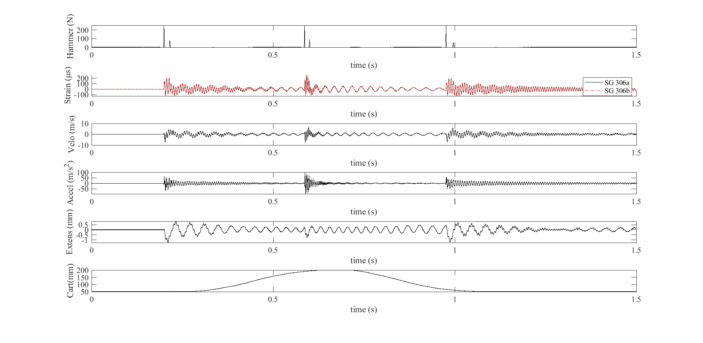
Datasets
High-Rate Overview
Benchmark
Applications
Datasets
Dataset 7 – test 10

Slide 58
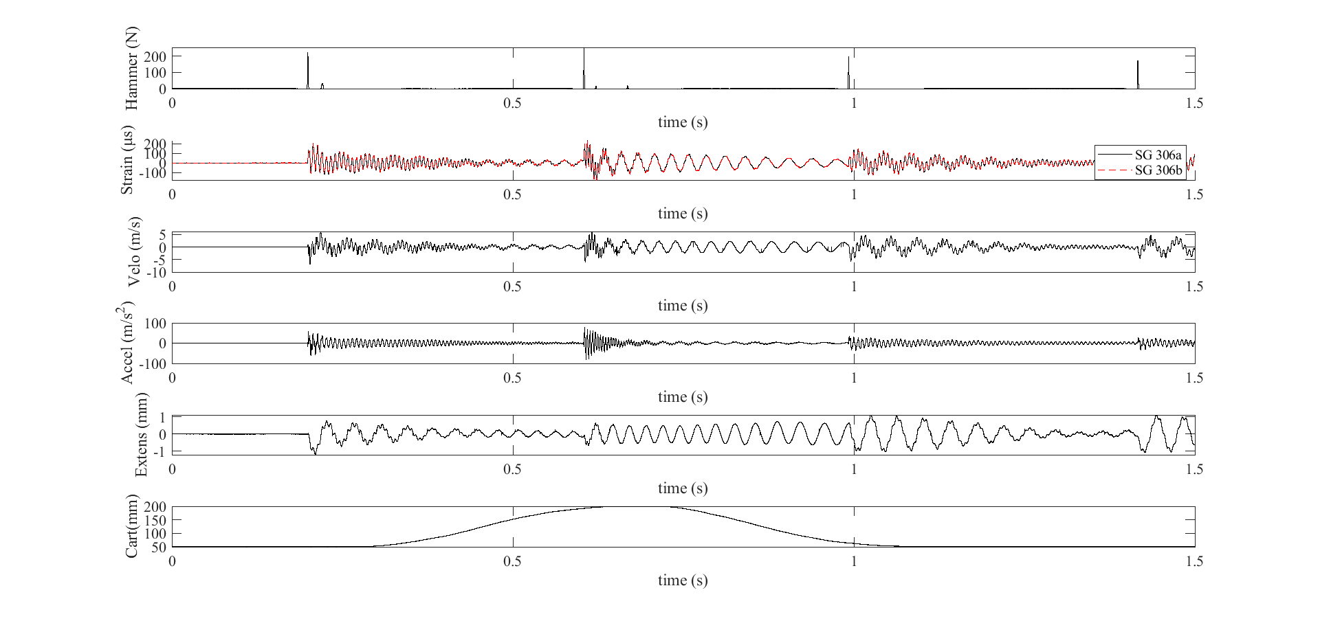
Datasets
High-Rate Overview
Benchmark
Applications
Datasets
Dataset 7 – test 11

Slide 59
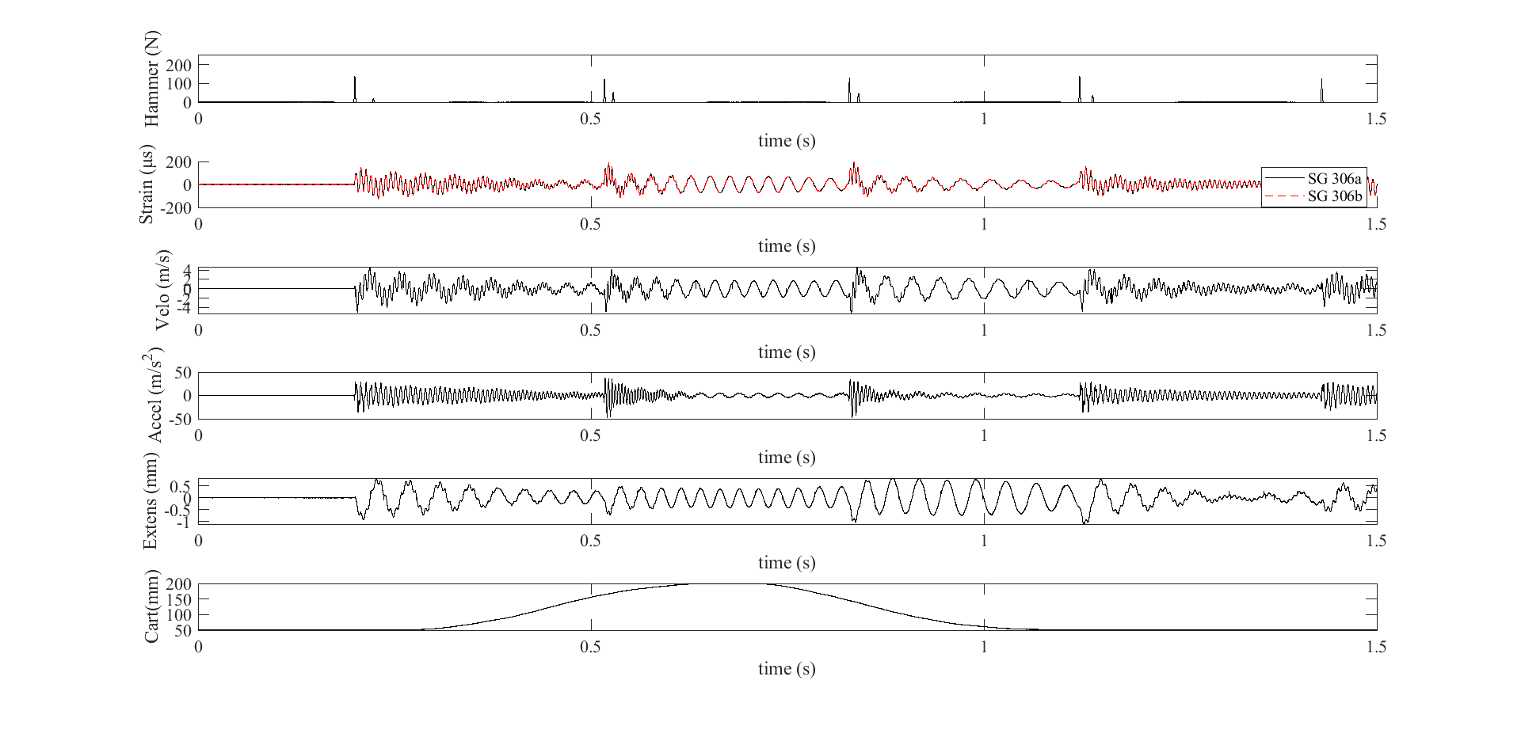
Datasets
High-Rate Overview
Benchmark
Applications
Datasets
Dataset 7 – test 12

Slide 60
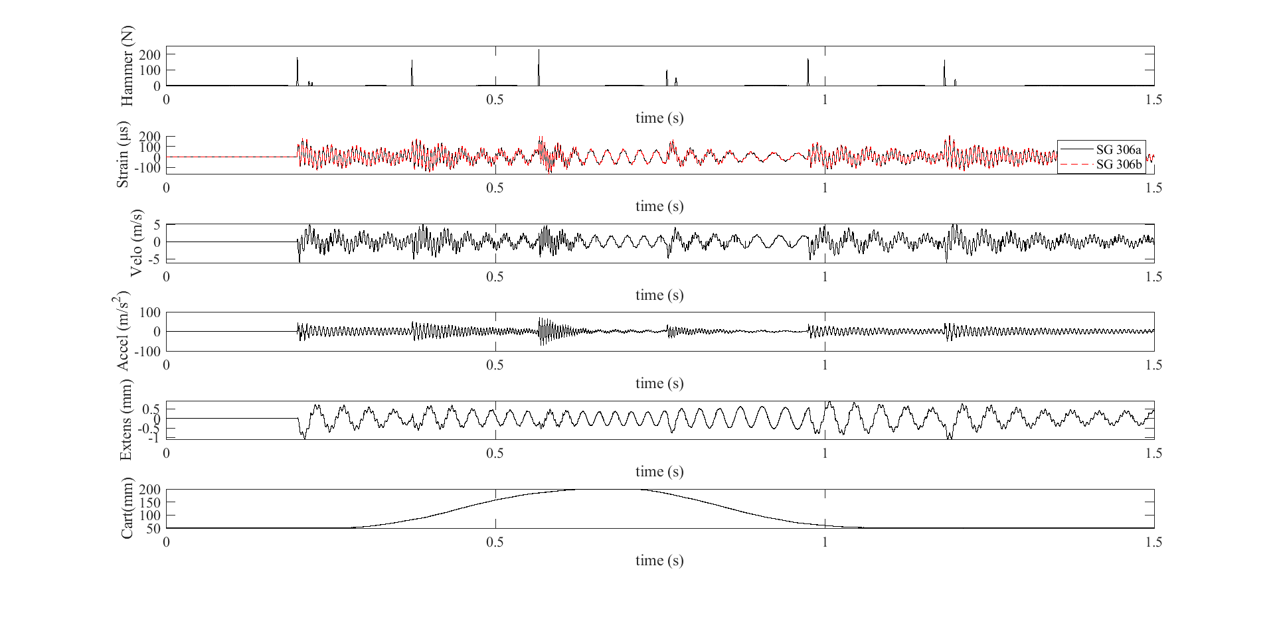
Datasets
High-Rate Overview
Benchmark
Applications
Datasets
Dataset 7 – test 13

Slide 61
Datasets
High-Rate Overview
Benchmark
Applications
Datasets
Dataset 8 – Sensors
Sensors:
2x Accelerometer (PCB 353B17)
SN 127691 – 300 mm
SN 139351 – 400 mm
9x Strain gauge
25 mm
75 mm
125 mm
175 mm
225 mm
275 mm
325 mm
375 mm
425 mm
Sampling frequency: 25,600 samples/s
Excitation notes
No cart used for testing
Mass remains for whole test duration
Single hammer impact at 0.1 sec

Slide 62
Datasets
High-Rate Overview
Benchmark
Applications
Datasets
Dataset 8 – test 1

Slide 63
Datasets
High-Rate Overview
Benchmark
Applications
Datasets
Dataset 8 – test 2

Slide 64
Datasets
High-Rate Overview
Benchmark
Applications
Datasets
Dataset 8 – test 3

Slide 65
Datasets
High-Rate Overview
Benchmark
Applications
Datasets
Dataset 8 – test 4

Slide 66
Datasets
High-Rate Overview
Benchmark
Applications
Datasets
Dataset 8 – test 5

Slide 67
Datasets
High-Rate Overview
Benchmark
Applications
Datasets
Dataset 8 – test 6

Slide 68
Datasets
High-Rate Overview
Benchmark
Applications
Datasets
Dataset 8 – test 7

Slide 69
Datasets
High-Rate Overview
Benchmark
Applications
Datasets
Dataset 8 – test 8

Slide 70
Datasets
High-Rate Overview
Benchmark
Applications
Datasets
Dataset 8 – test 9

Slide 71
Datasets
High-Rate Overview
Benchmark
Applications
Datasets
Dataset 8 – test 10

